Slide 1
Electrochemical Cell
Construction of Voltaic Cells
Notation for Voltaic Cells
Cell Potential
Standard Cell Potentials and Standard Electrode Potentials
Equilibrium Constants from Cell Potentials
Dependence of Cell Potential on Concentration
Some Commercial Voltaic Cells

Slide 2
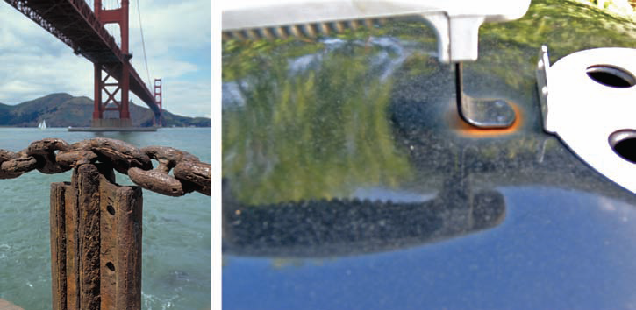
Electrochemistry: Corrosion
Corrosion, one result of electrochemistry, costs the U.S. economy an estimated $300 billion per year

Slide 3
Electrochemistry: Corrosion
Researchers have identified many different forms of corrosion. The rusting of automobile bodies is an example of uniform corrosion and is one of the most visible forms of corrosion.
Another important form of corrosion is galvanic corrosion, which occurs only when two different metals contact each other in the presence of an appropriate electrolyte.
Uniform Corrosion Galvanic Corrosion

Slide 4
Oxidation–Reduction Reactions
What happens to a piece of steel that sits outside, unprotected?
In most locations, it rusts.
Would you expect to observe the same thing if that piece of steel were inside a house or in a desert?
Perhaps not.
There must be some special conditions that promote the reaction of iron with oxygen to form iron(III) oxide.
We could design a set of experiments to study the formation of rust, but from a laboratory perspective, rust formation is rather slow. To find out more about the basics of electrochemistry, let’s begin with more easily observed reactions and then apply what we learn to examples of corrosion.

Slide 5
Oxidation–Reduction and Half-Reactions
Reactions involving the transfer of electrons are known as oxidation–reduction reactions. (The term is often inverted and shortened to redox reactions.)
Oxidation is the loss of electrons from some chemical species,
Reduction is the gain of electrons.
The species undergoing oxidation is referred to as a reducing agent.
The species undergoing reduction is referred to as an oxidizing agent.

Slide 6
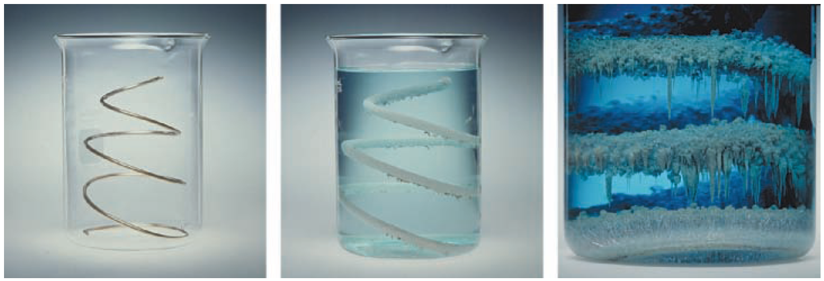
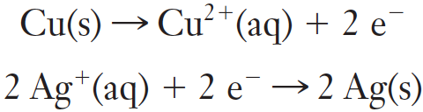
Oxidation–Reduction and Half-Reactions
A clean copper wire is placed into a colorless solution of silver nitrate
Oxidation Half-reaction
Reduction Half-reaction

Slide 7
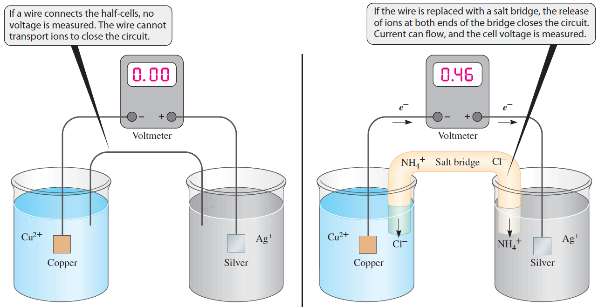
Building a Galvanic Cell
By allowing ions to flow into each half-cell, the bridge closes the circuit and allows current to flow.
A wire can carry a current of electrons, but it can not transport the ions needed to complete the circuit.

Slide 8
First Battery
The first battery was invented by Alessandro Volta about 1800.
(He assembled a pile consisting of pairs of zinc and silver disks separated by paper disks soaked in salt water. With a tall pile, he could detect a weak electric shock when he touched the two ends of the pile.)
A battery cell that became popular during the nineteenth century was constructed in 1836 by the English chemist John Frederick Daniell. This cell used zinc and copper.
(Each metal was surrounded by a solution of the metal ion, and the solutions were kept separate by a porous ceramic barrier. Each metal with its solution was a half-cell; a zinc half-cell and a copper half-cell made up one voltaic cell.)
This construction became the standard form of such cells, which exploit the spontaneous chemical reaction to generate electrical energy.

Slide 9
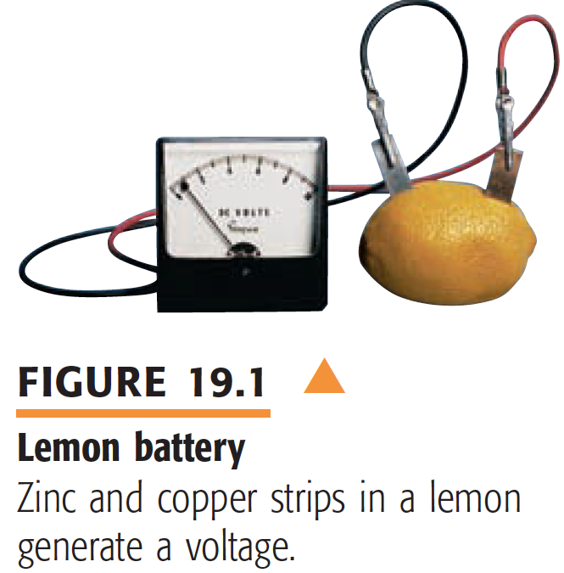
Lemon Battery

Slide 10
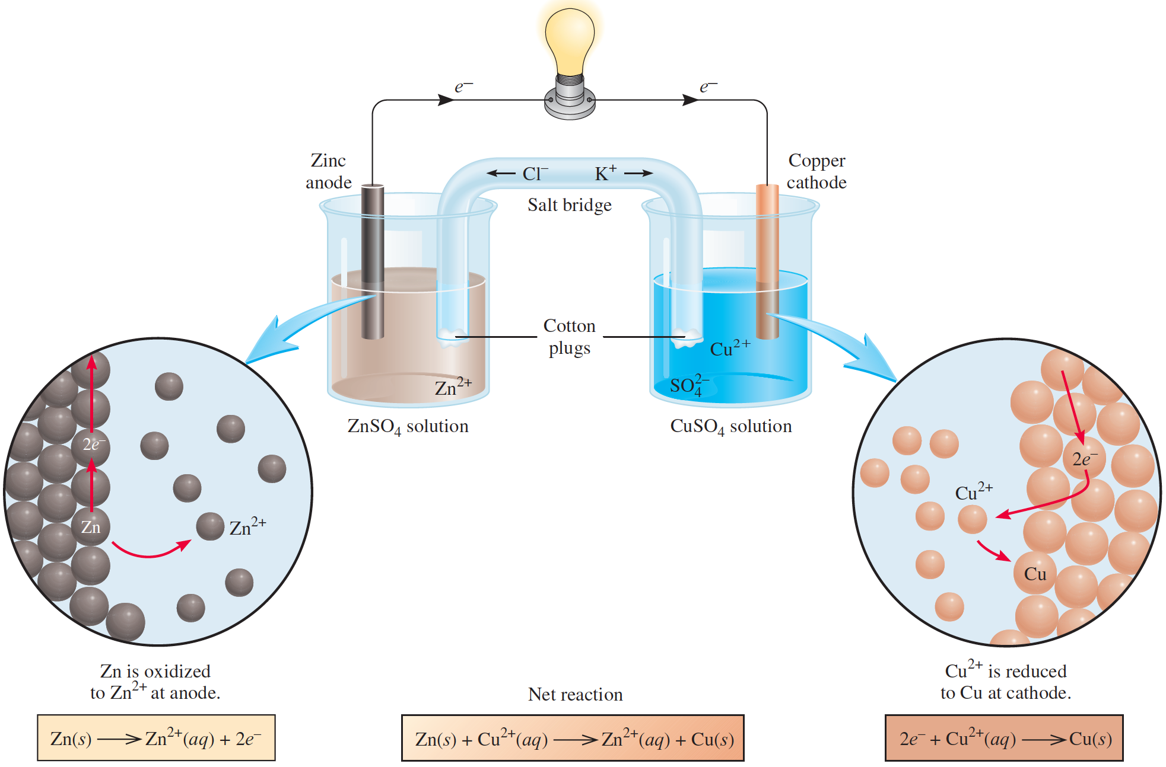
Galvanic Cells
The experimental apparatus for generating electricity through the use of a spontaneous reaction is called a galvanic cell

Slide 11
Electrodes: Anode and Cathode
The experimental apparatus for generating electricity through the use of a spontaneous reaction is called a galvanic cell or voltaic cell, after the Italian scientists Luigi Galvani and Alessandro Volta, who constructed early versions of the device.
A zinc bar is immersed in a ZnSO₄ solution, and a copper bar is immersed in a CuSO4 solution. The zinc and copper bars are called electrodes.
This particular arrangement of electrodes (Zn and Cu) and solutions (ZnSO₄ and CuSO₄) is called the Daniell cell.
The anode in a galvanic cell is the electrode at which oxidation occurs and the cathode is the electrode at which reduction occurs.

Slide 12
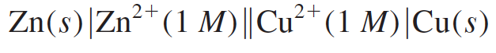
Cell Diagram
This cell notation lists the metals and ions involved in the reaction. A vertical line, Ι, denotes a phase boundary, and a double line, ΙΙ, represents the salt bridge.
The anode is always written on the left and the cathode on the right:

Slide 13
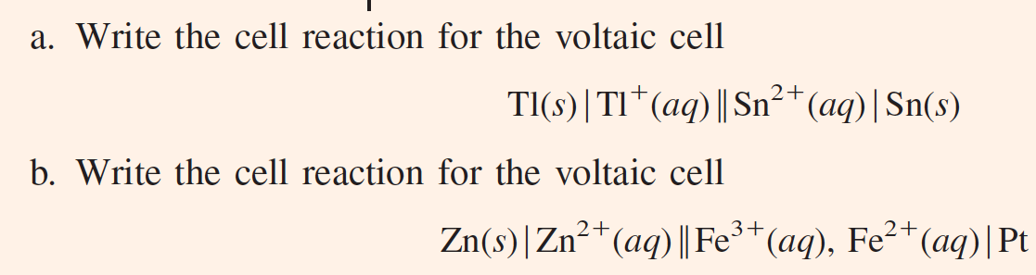
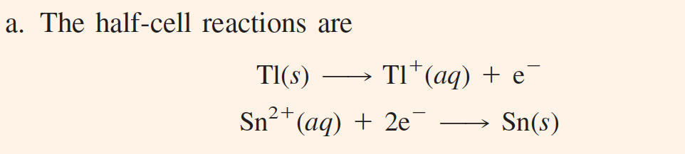
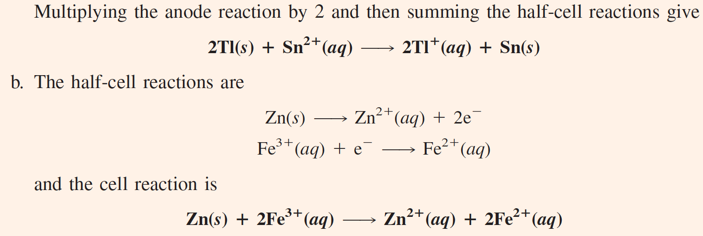

Slide 14
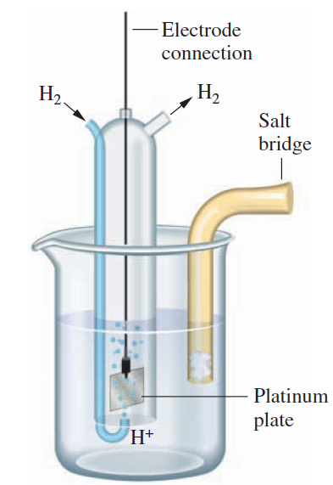
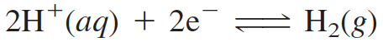
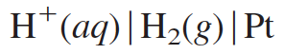
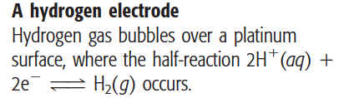
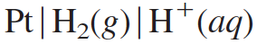
Hydrogen Electrode
When the half-reaction involves a gas, an inert material such as platinum serves as a terminal and as an electrode surface on which the half-reaction occurs. The platinum catalyzes the half-reaction but otherwise is not involved in it.
The cathode half-reaction:
The notation for the hydrogen electrode:
To write such an electrode as an anode, you simply reverse the notation:

Slide 15
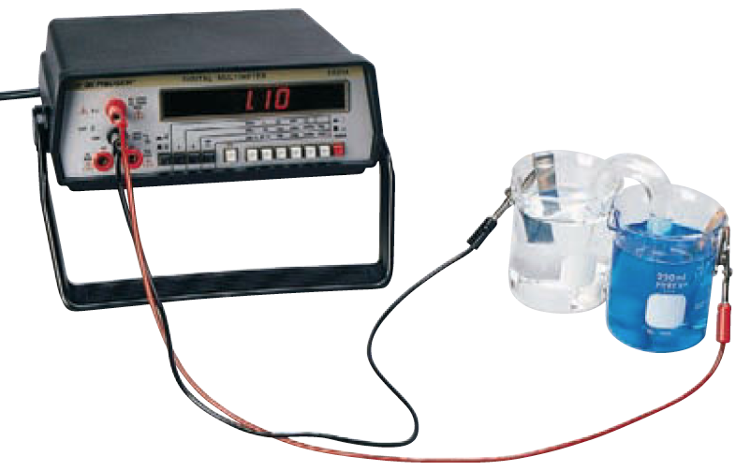
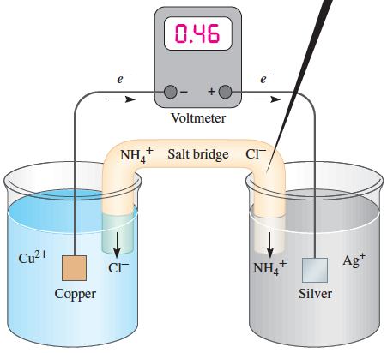
Cell Potential
Why the voltage obtained is different?

Slide 16

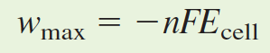
Cell Potential
Potential difference is the difference in electric potential (electrical pressure) between two points.
You measure this quantity in volts. The volt, V, is the SI unit of potential difference.
The electrical work expended in moving a charge through a conductor is
The maximum potential difference between the electrodes of a voltaic cell is referred to as the cell potential or electromotive force (emf) of the cell, or E_{cell}.
Here E_{cell} is the cell potential, and F is the Faraday constant, 96,485 C/mol e⁻.

Slide 17
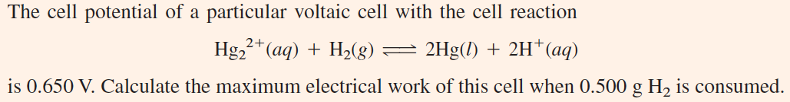
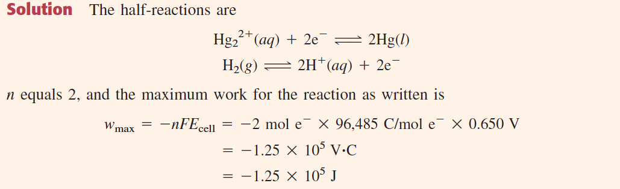
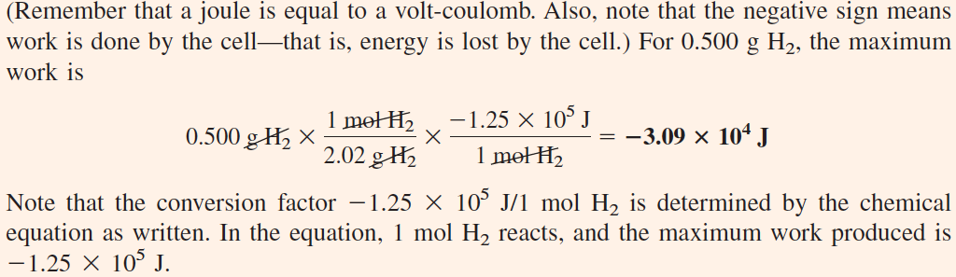

Slide 18
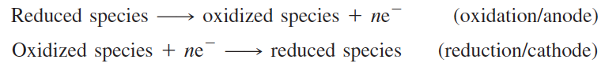
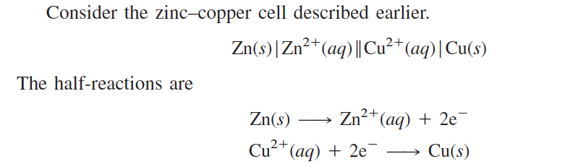
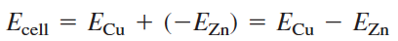
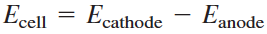
Cell Potential

Slide 19
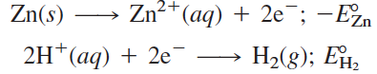
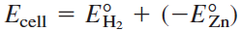
The standard cell potential, E°_{cell}, is the emf of a voltaic cell operating under standard-state conditions (solute concentrations are each 1 M, gas pressures are each 1 atm, and the temperature is 25°C).
The standard electrode potential, E°, is the electrode potential under standard-state conditions.
However, it is not possible to measure the potential of a single electrode; only the cell potentials of cells can be measured. By convention, the reference chosen for comparing electrode potentials is the standard hydrogen electrode, and it is assigned a potential of 0.00 V.
Now write the cell potential in terms of the electrode potentials.
and the half-reactions with corresponding half-cell potentials (oxidation or reduction potentials) are
The cell potential is the sum of the half-cell potentials.
Substitute 0.76 V for the cell potential and 0.00 V for the standard hydrogen electrode potential. This gives Eº_{Zn} = -0.76 V

Slide 20
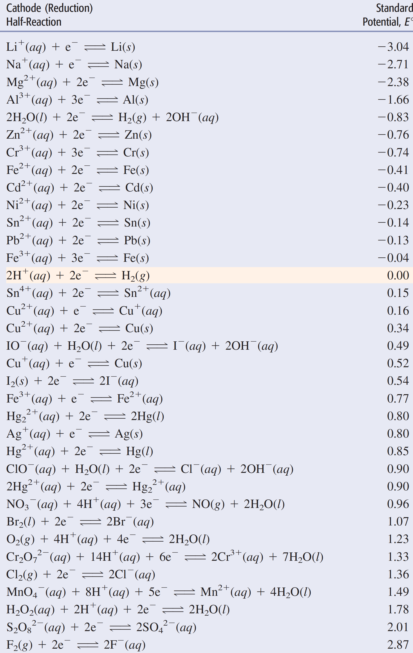
the strongest oxidizing agents in a table of standard electrode potentials are the oxidized species corresponding to half-reactions with the largest (most positive) E° values
the strongest reducing agents in a table of standard electrode potentials are the reduced species corresponding to half-reactions with the smallest (most negative) E° values

Slide 21
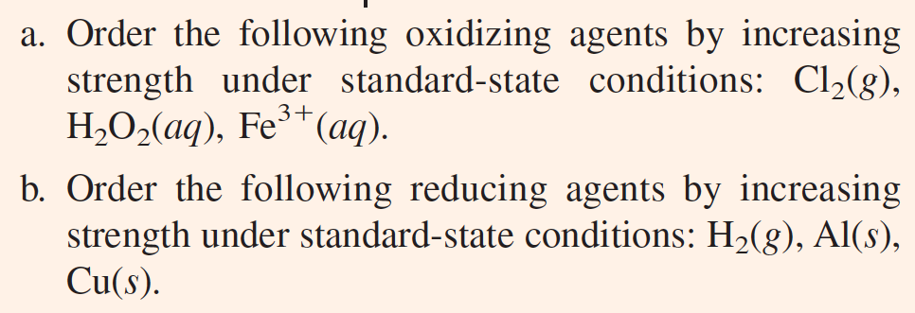
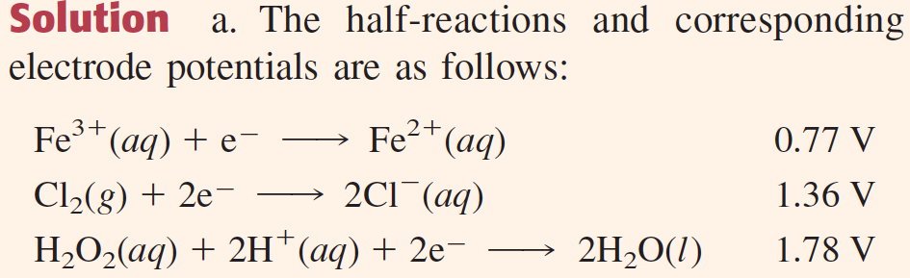
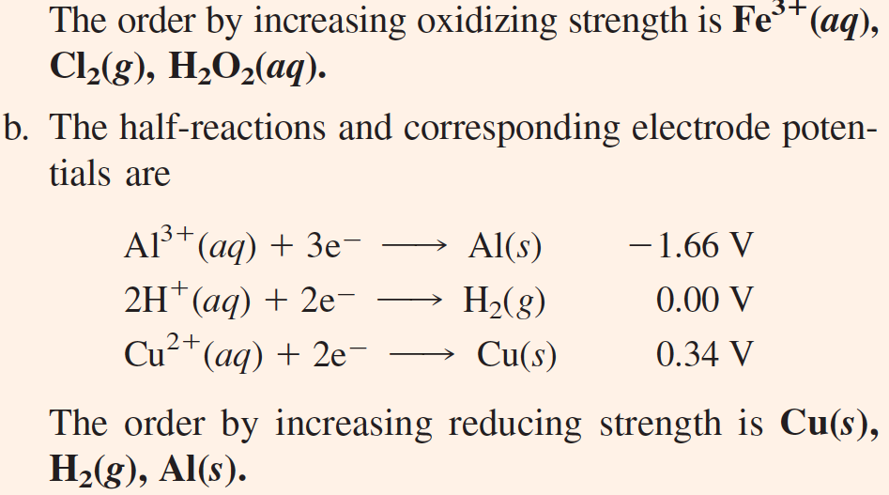

Slide 22
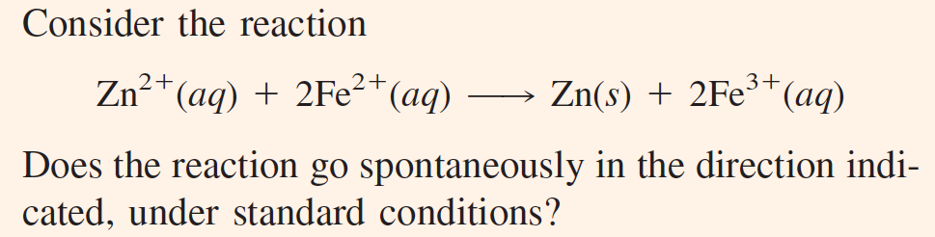
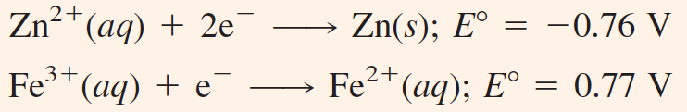

Slide 23
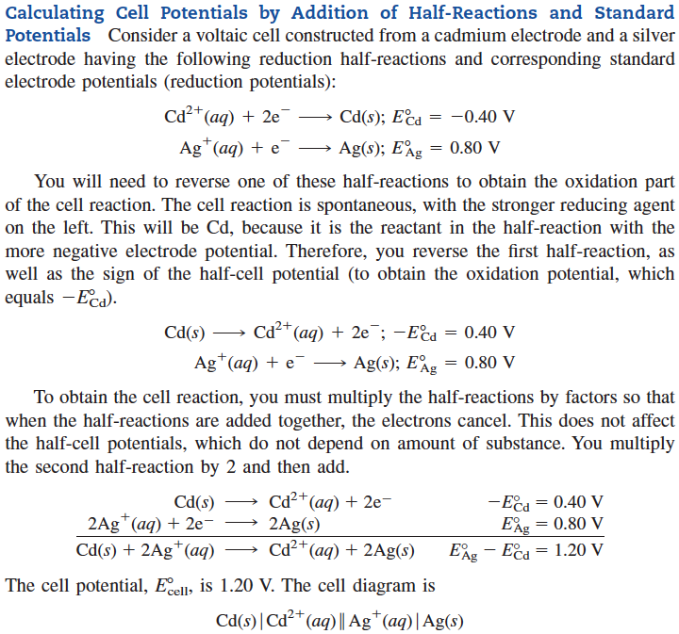

Slide 24
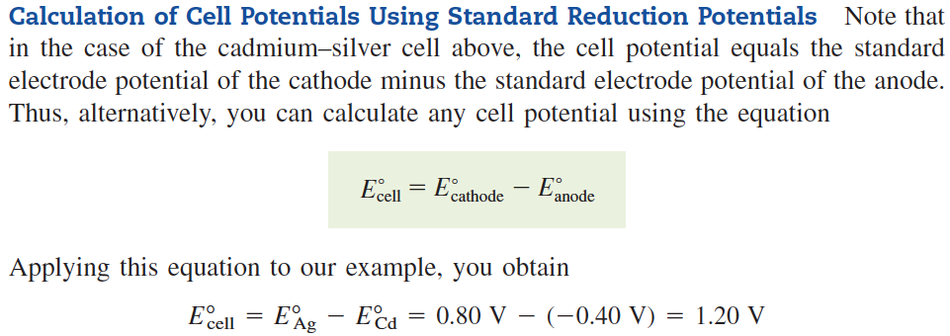

Slide 25
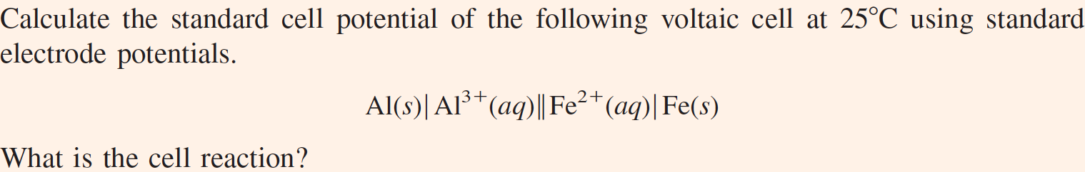
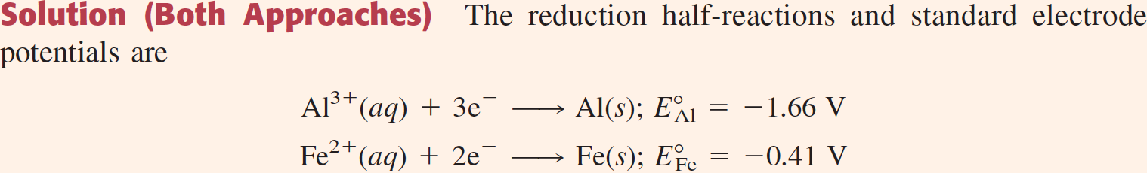
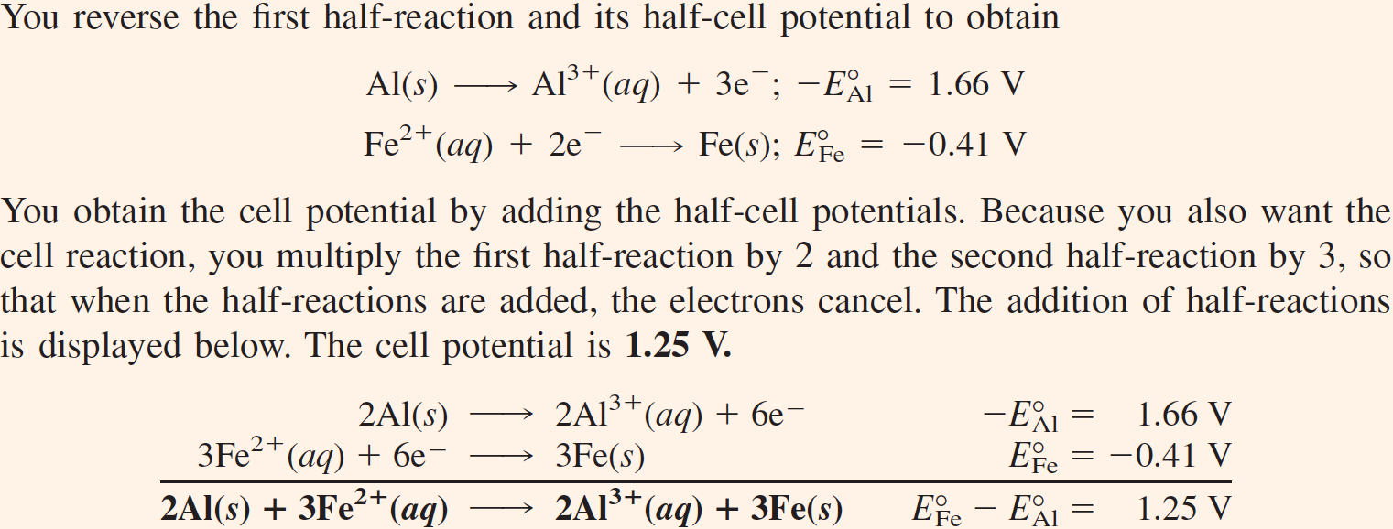

Slide 26
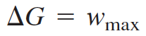
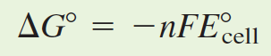
Equilibrium Constants from Cell Potentials
The free energy change ΔG for a reaction equals the maximum useful work of the reaction
For a voltaic cell, this work is the electrical work, -nFE_{cell} (where n is the number of moles of electrons transferred in a reaction), so when the reactants and products are in their standard states, you have

Slide 27
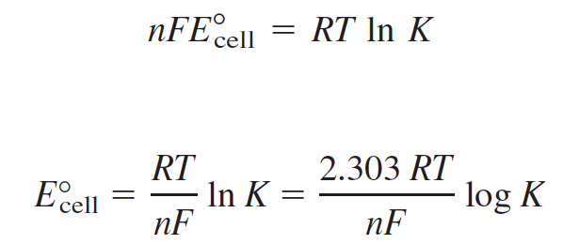
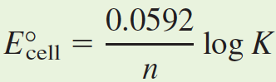
Combining the previous equation, ΔG° = -nFE°_{cell}, with the equation ΔG° = -RT ln K
Substituting values for the constants R and F at 25°C gives the equation

Slide 28
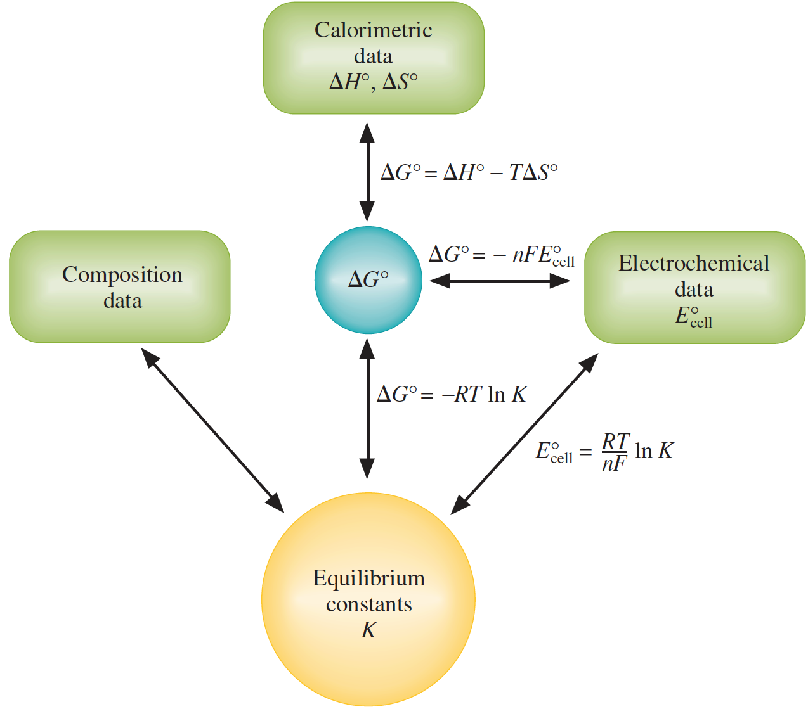

Slide 29
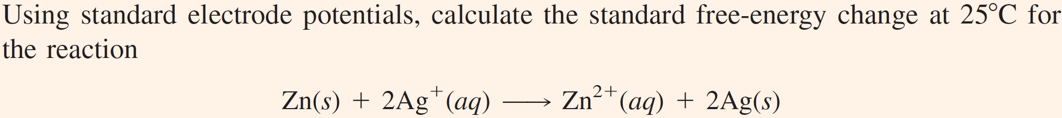
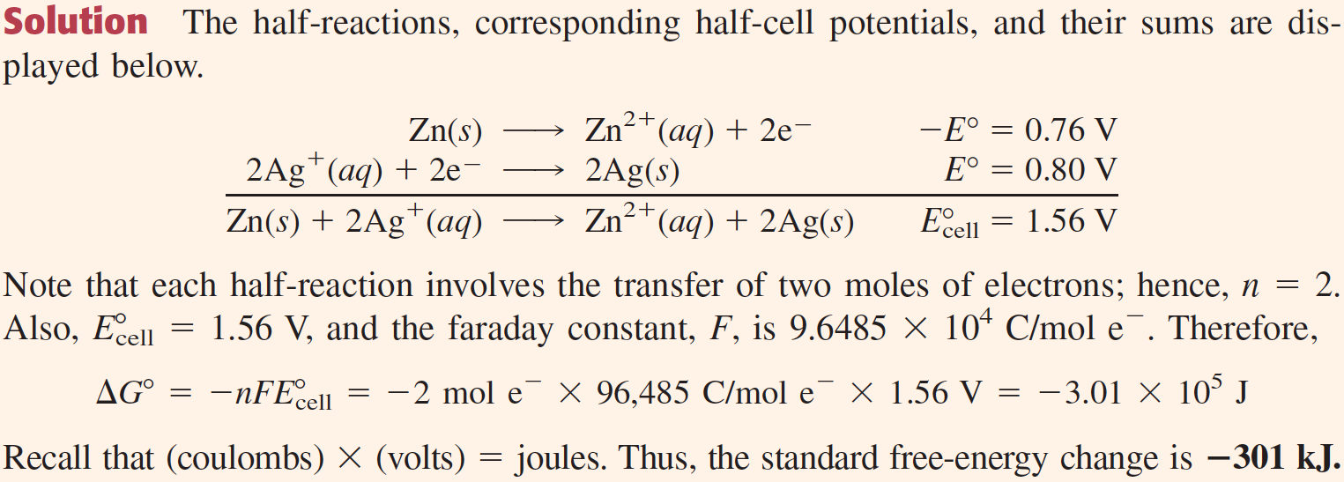

Slide 30
Dependence of Cell Potential on Concentration: Nernst Equation
The free-energy change, ΔG, is related to the standard free-energy change, ΔG°, by the following equation
ΔG = ΔG° + RT ln Q
Here Q is the thermodynamic reaction quotient. The reaction quotient has the form of the equilibrium constant, except that the concentrations and gas pressures are those that exist in a reaction mixture at a given instant.
Substituting ΔG = -nFE_{cell} and ΔG° = -nFE°_{cell} into this equation
-nFE_{cell} = -nFE°_{cell} + RT ln Q

Slide 31
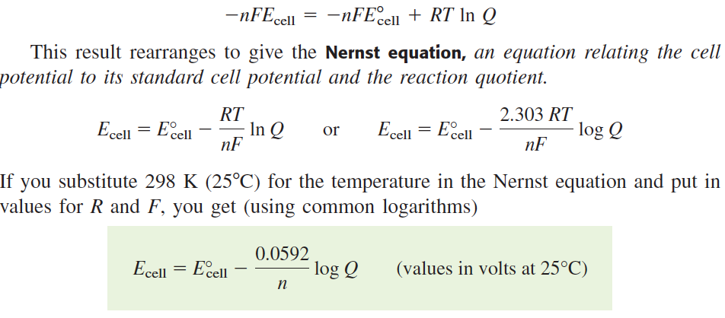
Nernst Equation

Slide 32
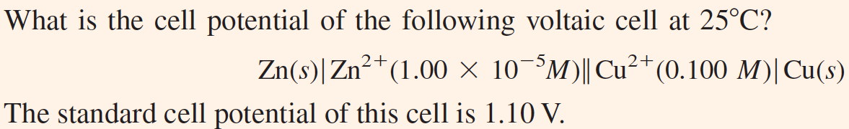
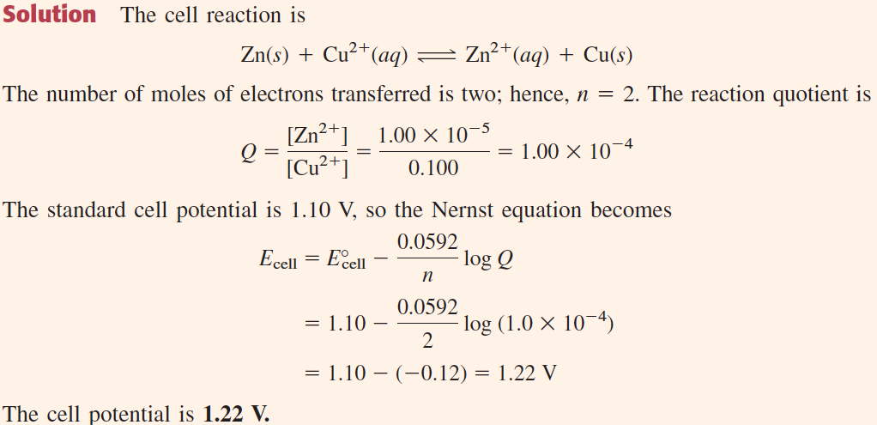

Slide 33
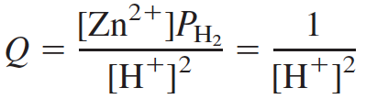
Determination of pH
The pH of a solution can be obtained very accurately from cell potential measurements, using the Nernst equation to relate cell potential to pH.
Use the test solution as the electrolyte for a hydrogen electrode and bubble in hydrogen gas at 1 atm.
Connect the hydrogen electrode to a standard zinc electrode.
The cell reaction is
The cell potential depends on the hydrogen-ion concentration of the test solution, according to the Nernst equation.

Slide 34
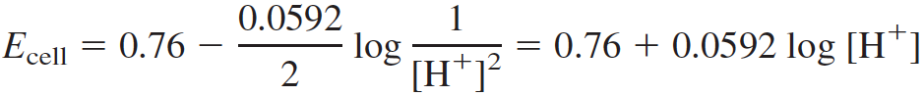


Determination of pH
Reaction quotient,
Substituting Q and E°_{cell} (= 0.76 V) into the Nernst equation,
where [H⁺] is the hydrogen-ion concentration of the test solution.
To obtain the relationship between the cell potential (E_{cell}) and pH, you substitute the following into the preceding equation:
The result is
Which you can rearrange to give the pH directly in terms of the cell potential:

Slide 35

Glass Electrode: pH Meter
The hydrogen electrode is seldom employed in routine laboratory work, because it is awkward to use.
It is often replaced by a glass electrode. This compact electrode consists of a silver wire coated with silver chloride immersed in a solution of dilute hydrochloric acid. The electrode solution is separated from the test solution by a thin glass membrane, which develops a potential across it depending on the hydrogen-ion concentrations on its inner and outer surfaces. A mercury–mercury(I)
chloride (calomel) electrode is often used as the other electrode. The cell potential depends linearly on the pH. In a common arrangement, the cell potential is measured with a voltmeter that reads pH directly.

Slide 36

Commercial Voltaic Cells
Flashlights and radios are examples of devices that are often powered by the zinc–carbon, or Leclanché, dry cell.
This voltaic cell has a zinc can as the anode; a graphite rod in the center, surrounded by a paste of manganese dioxide, ammonium and zinc chlorides, and carbon black, is the cathode.

Slide 37
Commercial Voltaic Cells
The electrode reactions are complicated but are approximately these:
The voltage of this dry cell is initially about 1.5 V, but it decreases as current is drawn off. The voltage also deteriorates rapidly in cold weather.
An alkaline dry cell is similar to the Leclanché cell, but it has potassium hydroxide in place of ammonium chloride. This cell performs better under current drain and in cold weather.

Slide 38

Commercial Voltaic Cells
Lithium–iodine battery, a voltaic cell in which the anode is lithium metal and the cathode is an I₂ complex.
These solid-state electrodes are separated by thin crystalline layer of lithium Iodide.
Current is carried through the crystal by diffusion of Li⁺ ions.
Although the cell has high resistance and therefore low current, the battery is very reliable and is used to power heart pacemakers. The battery is implanted within the patient’s chest and lasts about ten years before it has to be replaced.

Slide 39
Commercial Voltaic Cells
Once a dry cell is completely discharged (has come to equilibrium), the cell is not easily reversed, or recharged, and is normally discarded. Some types of cells are rechargeable after use, however.
Lead storage cell consists of electrodes of lead alloy grids; one electrode is packed with a spongy lead to form the anode, and the other electrode is packed with lead dioxide to form the cathode.
The half-cell reactions during discharge are
After the lead storage battery is discharged, it is recharged from an external electric current. The previous half-reactions are reversed. Some water is decomposed into hydrogen and oxygen gas during this recharging, so more water have to be added at intervals.
Maintenance-free batteries are sealed and consists the calcium–lead alloy that resists the decomposition of water.

Slide 40


Commercial Voltaic Cells

Slide 41
Fuel Cells
A fuel cell is essentially a battery, but it differs in operating with a continuous supply of energetic reactants, or fuel.
It consists a proton-exchange membrane (PEM) that uses hydrogen and oxygen. On one side of the cell, the anode, hydrogen passes through a porous material containing a platinum catalyst, allowing the following reaction to occur:
The H⁺(aq) ions then migrate through a proton-exchange membrane to the other side of the cell to participate in the cathode reaction with O₂(g):
The net reaction in the fuel cell:
The first applications of PEM fuel cells were in space, but more recently, they have provided power for lighting, emergency power generators, communications equipment, automobiles, and buses.

Slide 42

Fuel Cells

Slide 43

Back to Rusting
The electrochemical process involved in the rusting of iron
A single drop of water containing ions forms a voltaic cell in which iron is oxidized to iron(II) ion at the center of the drop (this is the anode). Oxygen gas from air is reduced to hydroxide ion at the periphery of the drop (the cathode). Hydroxide ions and iron(II) ions migrate together and react to form iron(II) hydroxide. This is oxidized to iron(III) hydroxide by more O₂ that dissolves at the surface of the drop. Iron(III) hydroxide precipitates, and this settles to form rust on the surface of the iron.

Slide 44
That’s it folks!
Thank you! I appreciate your help and attention in the classes. Hope you had fun learning the beauty of chemistry!
A short note to ponder…..
“IF YOU WANT TO WALK ON WATER, YOU HAVE TO GET OUT OF THE BOAT.”
“ When teachers want students to grow, they don’t give them answers - they give them problems! … It is only in the process of accepting and solving problems that our ability to think creatively is enhanced, our persistence is strengthened, and our self-confidence is deepened.
If someone gives {you} the answers to the test, {you} may get a good score on the test, but {you} have NOT grown.”
From John Ortberg’s “If you want to walk on water you’ve got to get out of the boat.”

